Slide 1
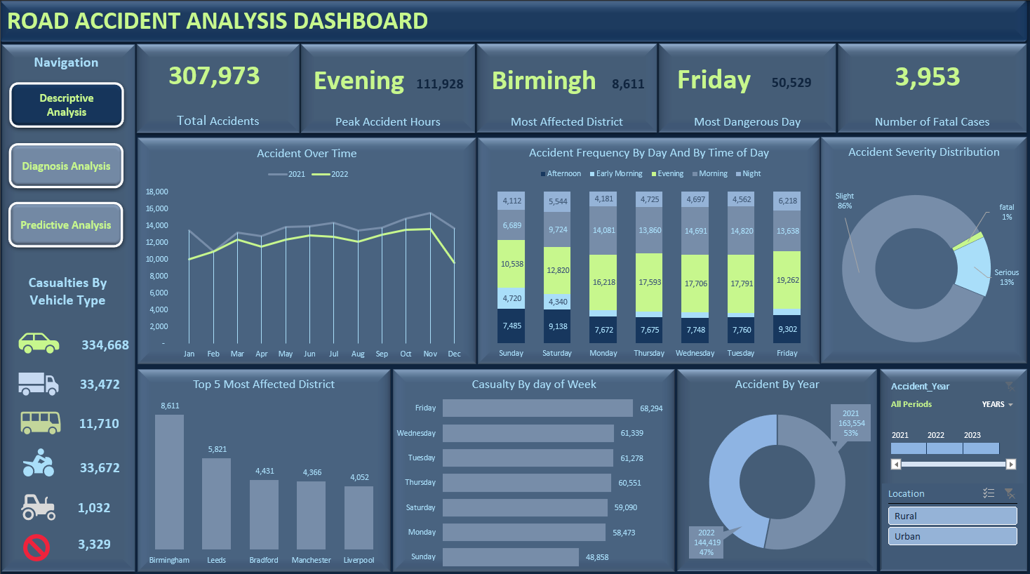
Capstone Analysis Project
10Alystics Group 4
Notes:
Title

Slide 2
Descriptive Analysis
Our analysis shows a decline in accident cases from 2021 to 2022,a shown in our trend line hence indicating improved road safety or effective interventions.
Moreover, accidents are most frequent during the evening hours (particularly between 4–8 PM) and in the morning 6-12. This pattern can be attributed to increased traffic during rush hour, driver fatigue after a full workday, reduced visibility as daylight fades.
Fridays is the dangerous day due to the records of numerous accidents often involve more travel, social outings, and end-of-week stress, all of which contribute to elevated accident risk..

Slide 3
Analysing Accident severity
Based on the analysis, the majority of recorded accidents—approximately 86%—were classified as Slight, indicating relatively minor injuries or damage. Serious accidents accounted for 13%, while only 1% were fatal. Although fatal cases are the least frequent, they involve the most severe consequences, including loss of life and multiple casualties.
Meaning we had more slight cases.

Slide 4
Analysing top 5 most affected states/district
Based on the analysis of casualty data, the top five most affected districts reported the highest number of accident-related casualties, indicating concentrated areas of road safety concern.
These districts may experience higher traffic density, inadequate road infrastructure, or lower traffic regulations, all contributing to elevated casualty rates. This pattern suggests a need for district-specific interventions, such as enhanced traffic law enforcement, improved signage and road conditions, targeted public awareness campaigns, and investment in emergency response systems. Prioritizing these high-risk districts can significantly reduce the overall number of casualties and improve transportation safety.

Slide 5
Diagnosis analystics
Our findings reveal that the majority of accident cases occurred at low speed, significantly more than those at high or moderate speeds. it reflects that low-speed environments are mostly congested traffic zones, higher vehicle and pedestrian interaction which are more prone to frequent minor collisions and slight injuries (accident)
However, fatal cases were predominantly linked to high-speed accidents, highlighting the severe consequences when collisions occur at greater velocities. This underscores the need for targeted safety measures in both low- and high-speed zones

Slide 6
Light Conditions analysis
Our analysis indicates that most accidents occurred during daylight hours, which is likely due to the fact that this period coincides with peak traffic activity, Like commercial transport, school runs, and general public movement. Increased exposure on the roads naturally raises the likelihood of collisions, even with better visibility.
Additionally, daylight hours often involve higher pedestrian activity, frequent stops, and more complex traffic interactions, especially in urban settings. While visibility is generally better in daylight, the volume and diversity of road users during this time significantly contribute to the higher accident rate. This finding emphasizes the need for efficient traffic management, road user education

Slide 7
Analystics based on weather conditions
Analysis reveals that most accidents occurred under fine weather conditions, rather than during rainy, snowy, or foggy weather. While adverse weather is often assumed to increase accident risk, this finding highlights that clear weather typically coincides with higher traffic volumes and a greater sense of driver confidence, which can lead to speeding, or reduced vigilance. whereas, drivers tend to be more cautious and alert in poor weather conditions. The higher frequency of accidents during fine weather suggests that driver behavior, traffic density, and road activity play a more critical role in accident occurrence than weather alone

Slide 8
Analystics based on weather conditions/road surface conditions
Analysis reveals that most accidents occurred under fine weather conditions, rather than during rainy, snowy, or foggy weather. While adverse weather is often assumed to increase accident risk, this finding highlights that clear weather typically coincides with higher traffic volumes and a greater sense of driver confidence, which can lead to speeding, or reduced vigilance. whereas, drivers tend to be more cautious and alert in poor weather conditions. The higher frequency of accidents during fine weather suggests that driver behavior, traffic density, and road activity play a more critical role in accident occurrence than weather alone

Slide 9
Road type
We observe that more accidents occurred on single carriageways than on other road types. This is likely because single carriageways typically doesnot have the physical barriers separating opposing traffic flows, which increases the risk of head-on collisions.
Additionally, single carriageways often have limited visibility, and fewer opportunities for safe overtaking, all of which contribute to higher accident rates. In contrast, dual carriageways and roundabouts are generally designed to better manage traffic flow and reduce conflict points, making them safer for

Slide 10
Accident on rural vs urban area
Following our analysis, we observed that the number of accident cases was higher in urban areas than in rural areas, while the number of fatal cases was higher in rural areas. This pattern can be attributed to several factors.
Urban areas typically have higher traffic volumes and more complex road networks, which lead to more frequent, but generally less severe, accidents due to lower speeds and better emergency response times.
In contrary, rural areas often feature higher speed limits, and roads with fewer safety features, all of which contribute to a greater likelihood of fatal outcomes when accidents do occur.

Slide 11
Thank you all for your kind attention
Notes:
Title

